Slide 1
LOOK HOW AT LAKES WE LIKE TO……..

Slide 2
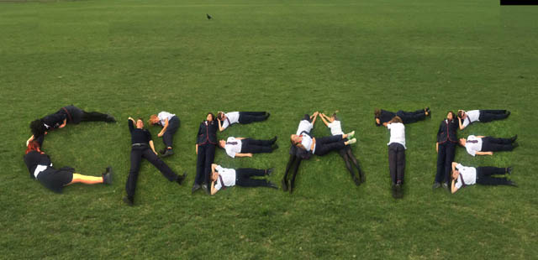

Slide 3
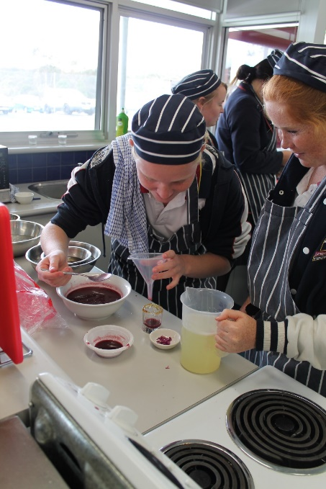
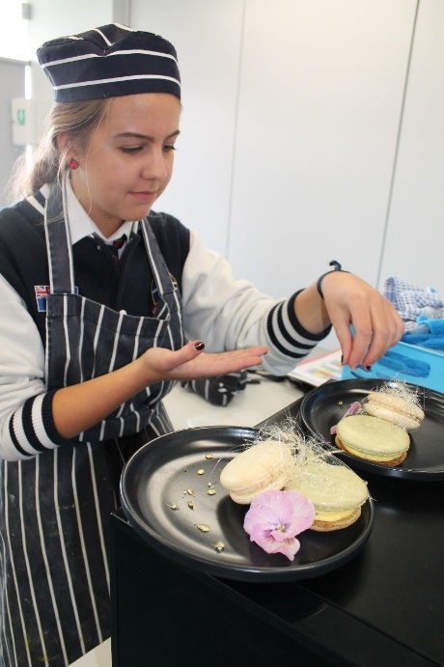
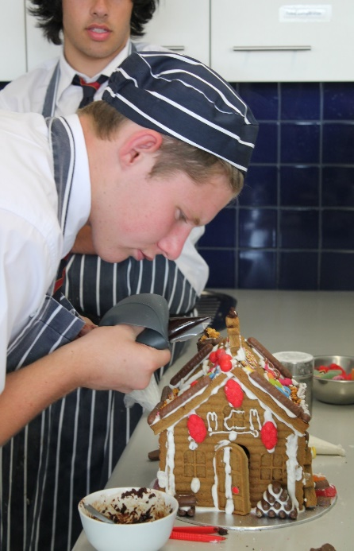
EDIBLE MASTERPIECES – Year 10 Food Technology
Add a description of this spotlight here. Add a description of this spotlight here.
Add a description of this spotlight here. Add a description of this spotlight here.

Slide 4
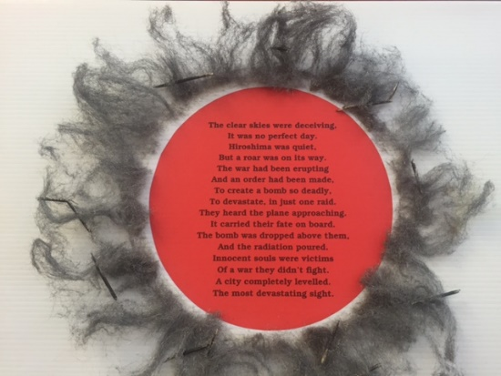
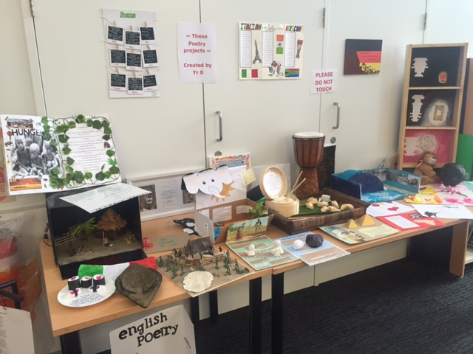
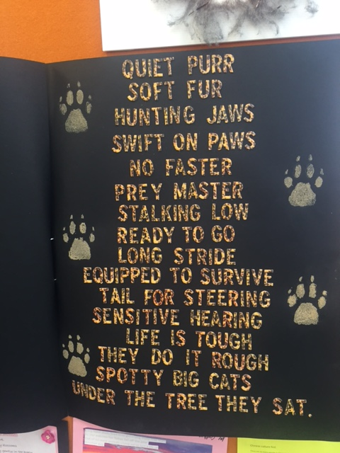
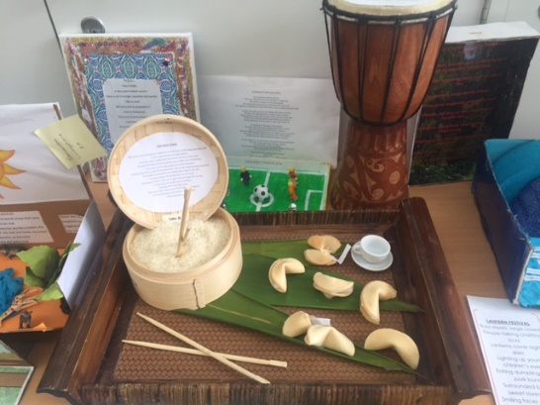
Year 8 Poetry Exploring Our World
Add a description of this spotlight here. Add a description of this spotlight here.
Add a description of this spotlight here. Add a description of this spotlight here.

Slide 5
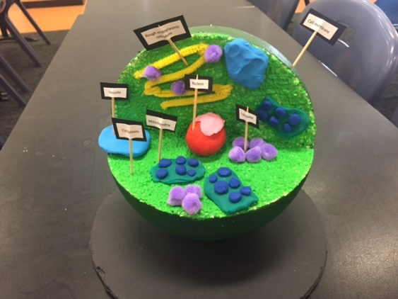
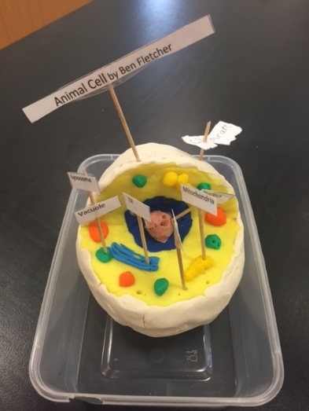
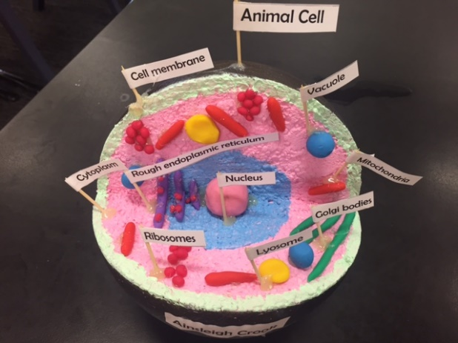
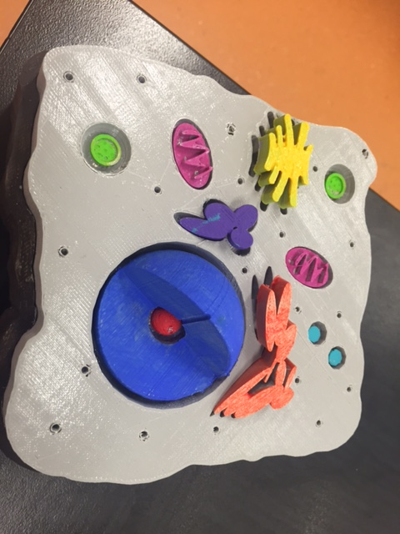
Year 8 Science Cell Models What are we made of?
Add a description of this spotlight here. Add a description of this spotlight here.

Slide 6
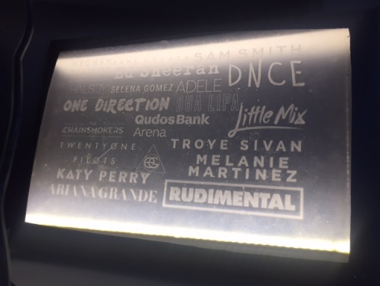
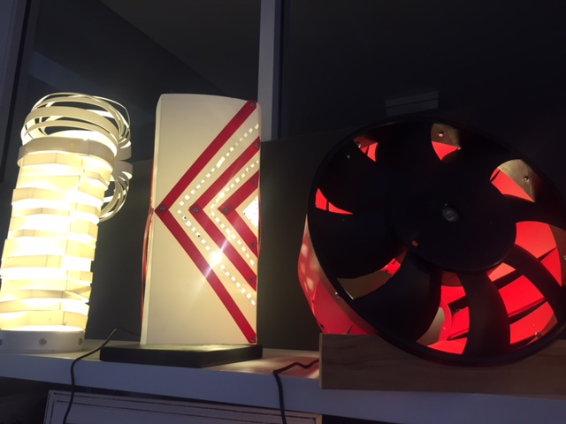
A Light Show! Year 9 D&T

Slide 7
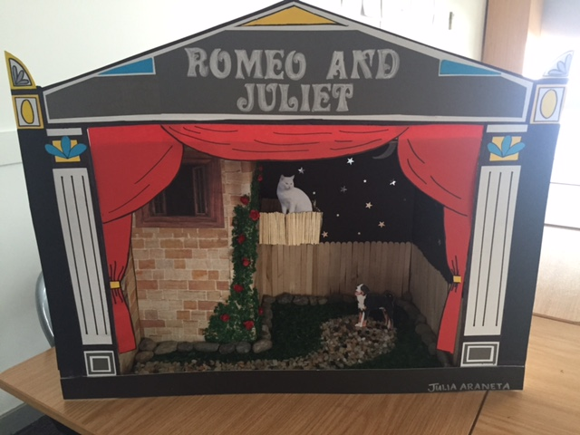
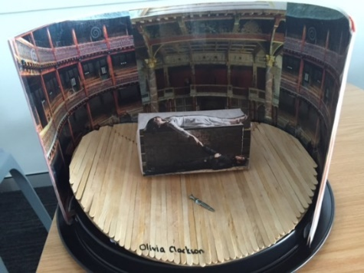
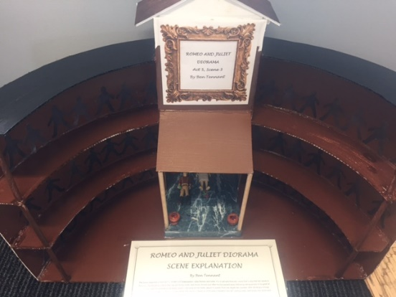
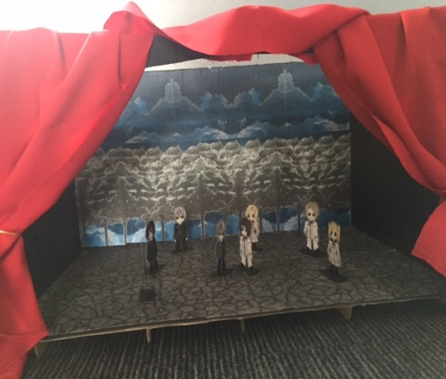
Wherefore Art Thou Romeo?’ Year 9 Shakespeare DIORAMAS
Add a description of this spotlight here. Add a description of this spotlight here.

Slide 8
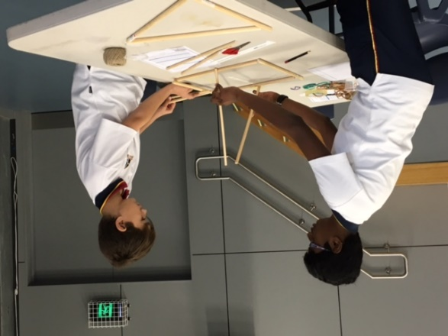
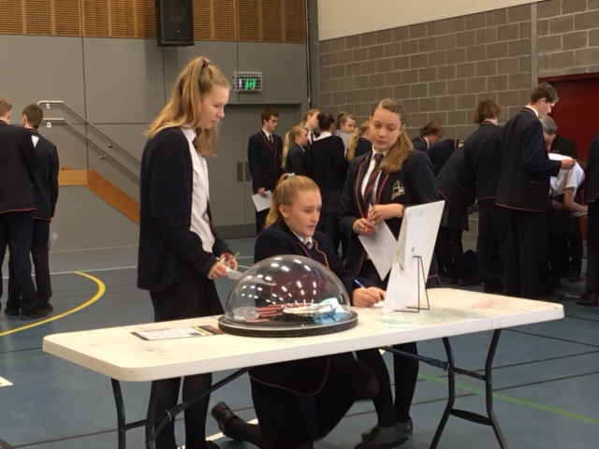
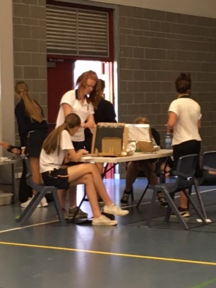
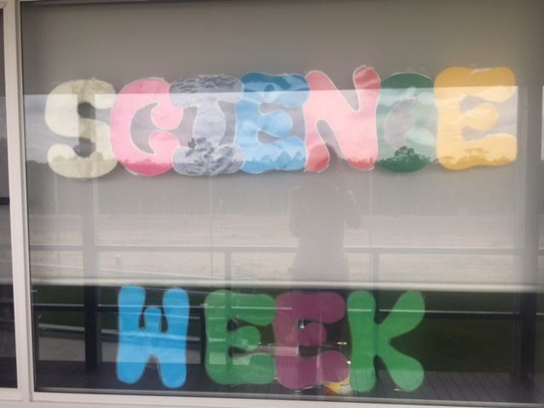
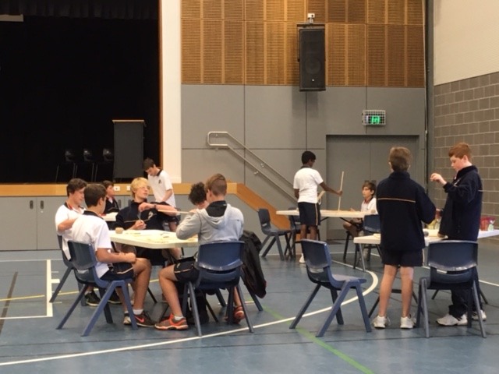
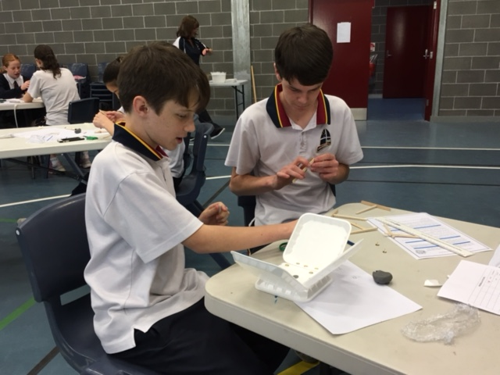

Slide 9
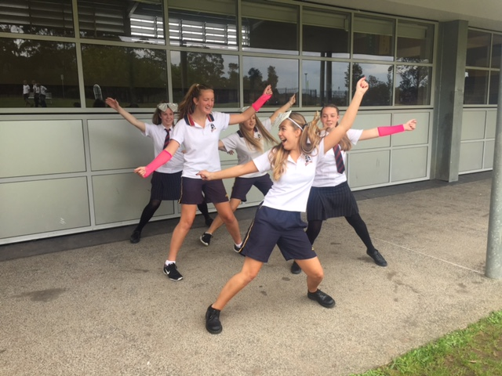
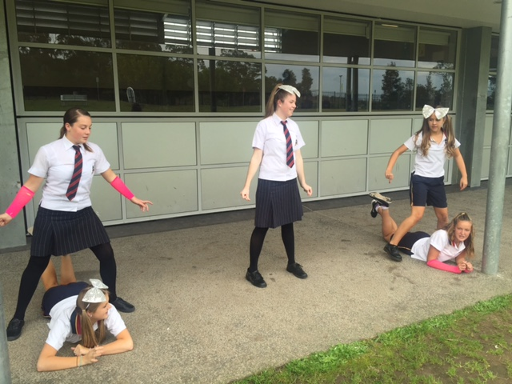
Dancing Queens! Year 10 PDHPE

Slide 10
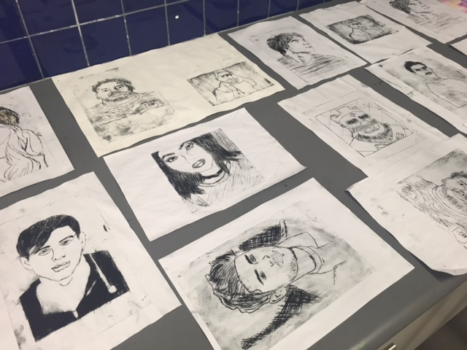
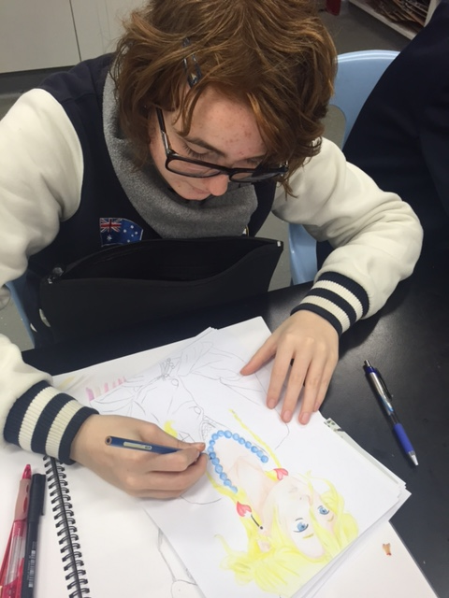
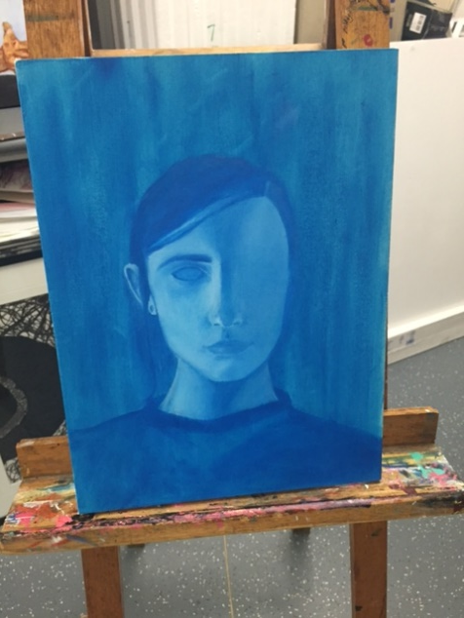
ART CLUB – PORTRAITS ARE THE RAGE!
Add a description of this spotlight here. Add a description of this spotlight here.

Slide 11
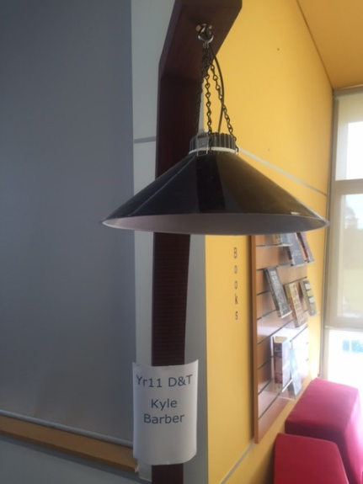
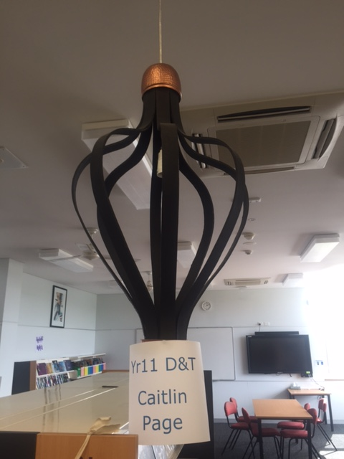
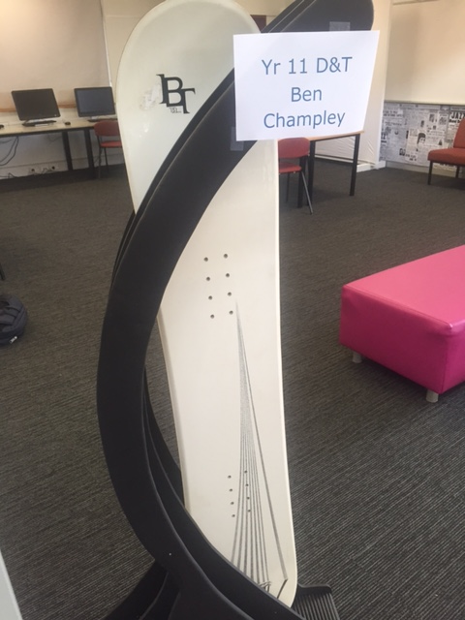
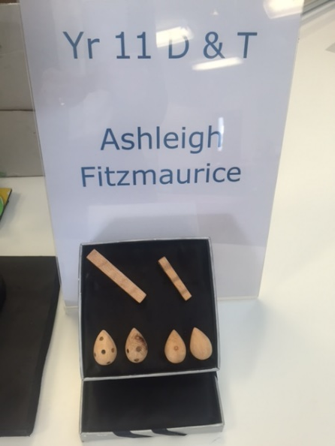
Year 11 D&T Projects
Add a description of this spotlight here. Add a description of this spotlight here.

Slide 12
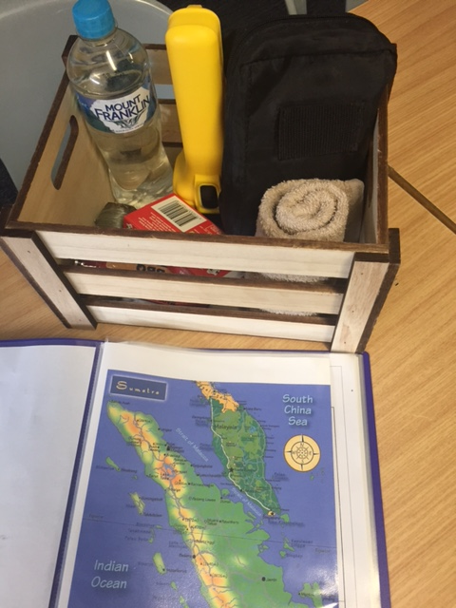
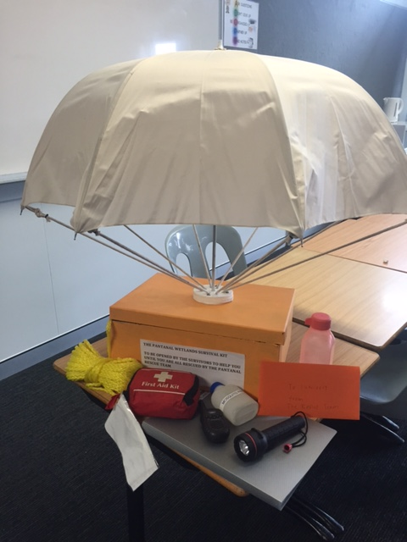
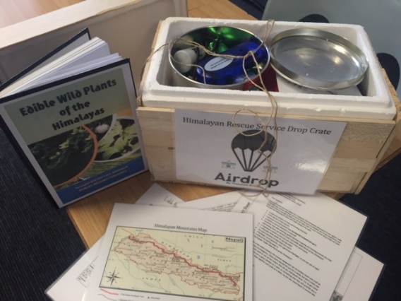
Year 7 Geography – Global Environments Survival Kits
Add a description of this spotlight here. Add a description of this spotlight here.

Slide 13
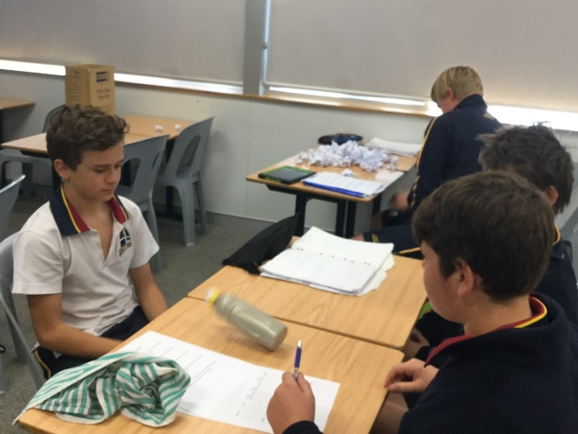
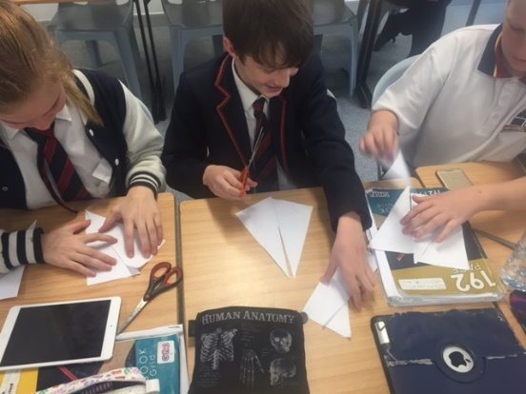
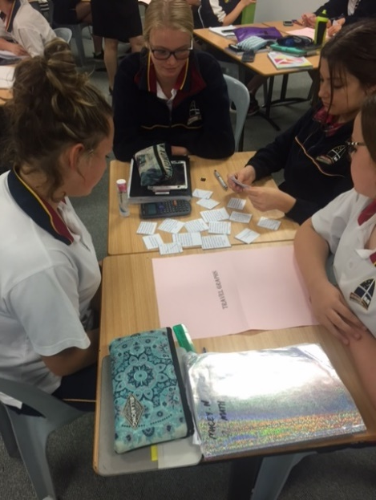
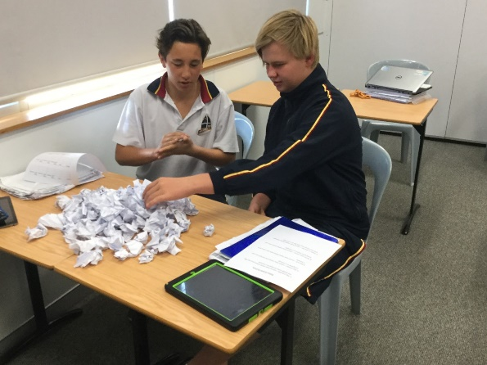
Maths are making things!!!!!!

Slide 14
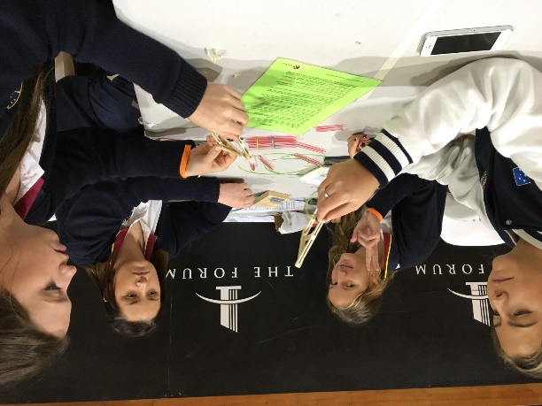
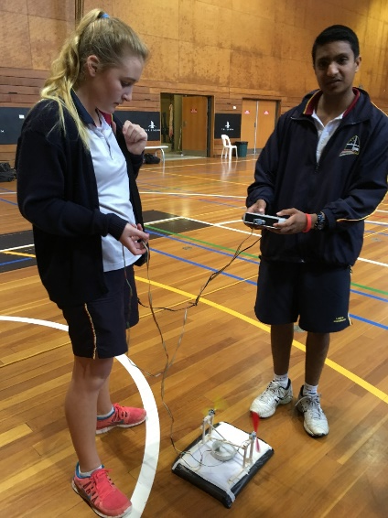
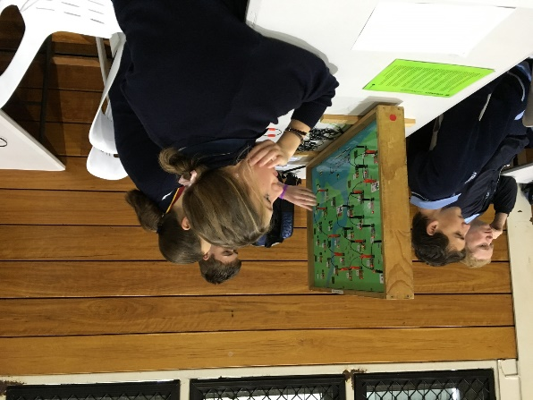
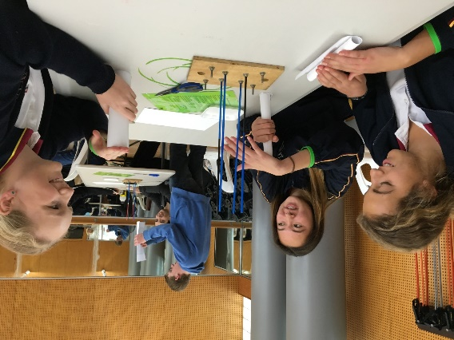
Science & Engineering Challenge

Slide 15
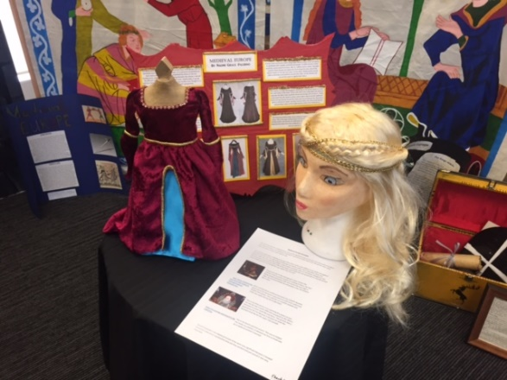
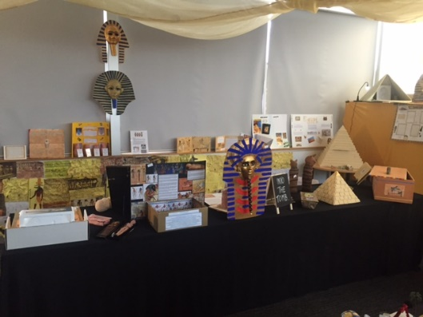
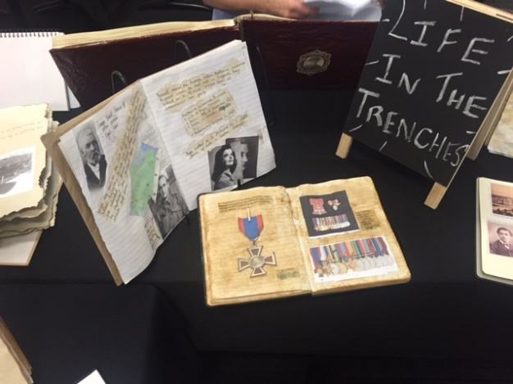
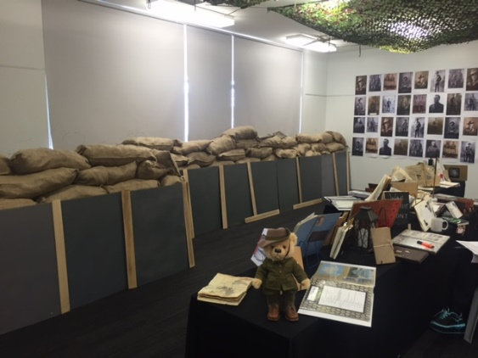
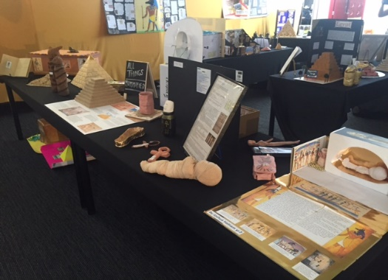
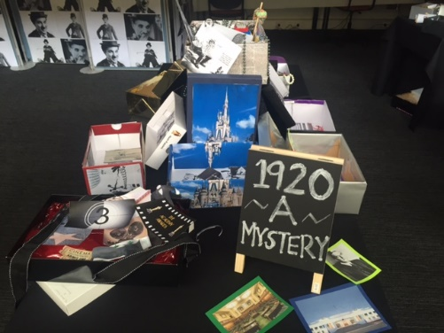
There was a Night at the Museum…….

Slide 16
Nothing Came Alive……..But What Happened?

Slide 17
Oh What A BEAUTIFUL Night…..THE ART EXHIBITION

Slide 19
Year 7 Textiles – CUSHIONS GALORE!

Slide 20
Max Potential – Well done Oscar !

Slide 21
YEAR 12 – MAKING MUSIC!
Add a description of this spotlight here. Add a description of this spotlight here.
Add a description of this spotlight here. Add a description of this spotlight here.

Slide 22
Year 12 D&T Major Projects

Slide 23
Year 12 Extension 2 English Major Works

Slide 24
Year 12 ART - Major Works

Slide 26
CONGRATULATIONS
EVERYONE
ON ALL YOUR CREATIONS THIS TERM!

Slide 27
WHAT WILL
YOU
CREATE
NEXT TERM

